Slide 1
Effect of Covid19 on AQI of India
By Boomerz
Team Members: Anirudh Sridhar (Leader)
Arihant Kaushik
Gaurav Bharadwaj
Rohit Raju
Shivam Kumar

Slide 2
Objective
We have selected this topic to explore and learn about how AQI in India has been affected by the lockdown, and to verify the fact if Pollution has been reduced by studying the data we have collected from multiple places.

Slide 3
Methodology
First, we have studied the data from 2015-2020
After Studying the data we have visualized the data
Then we have compared 2019 data with 2020 data

Slide 4
Data Collection and Cleaning
We have collected different datasets from different sites like kaggle etc.
There were many empty values which we filled using mean methods, some were dropped, or combined different columns into one.
We calculated AQI using PMI 2.5.

Slide 5
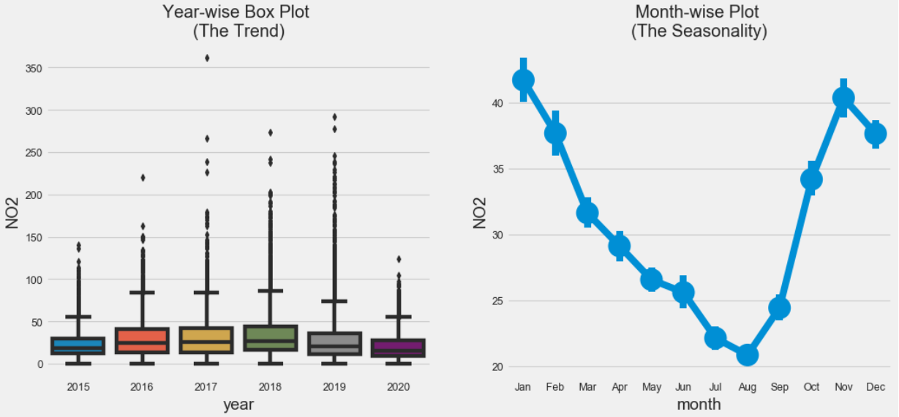
Data Analysis
First we plotted Graphs for each pollutants pm2.5, pm10 at city level.

Slide 6
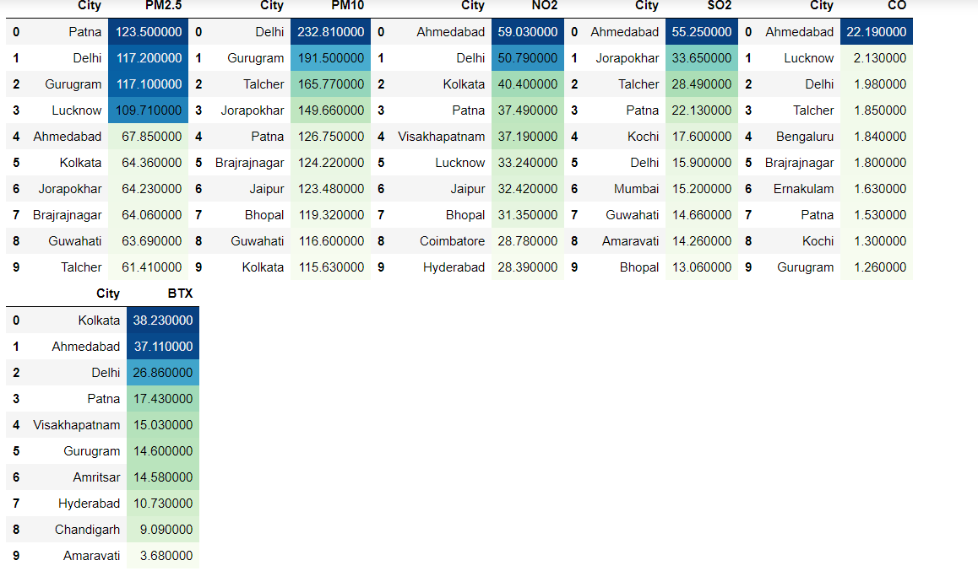
We displayed top 10 cities for each pollutants.

Slide 7
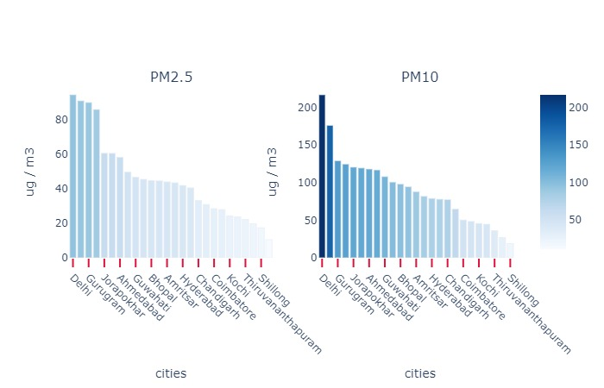
Particulate Matter Graph

Slide 8
Effect of Lockdown on AQI : Introduction
An air quality index (AQI) is used by government agencies to communicate to the public how polluted the air currently is or how polluted it is forecast to become.
There are six AQI categories, namely Good, Satisfactory, Moderately polluted, Poor, Very Poor, and Severe. The proposed AQI will consider eight pollutants (PM10, PM2.5, NO2, SO2, CO, O3, NH3, and Pb) for which short-term (up to 24-hourly averaging period) National Ambient Air Quality Standards are prescribed.
Based on the measured ambient concentrations, corresponding standards and likely health impact, a sub-index is calculated for each of these pollutants.
The worst sub-index reflects overall AQI. Likely health impacts for different AQI categories and pollutants have also been suggested, with primary inputs from the medical experts in the group.

Slide 9
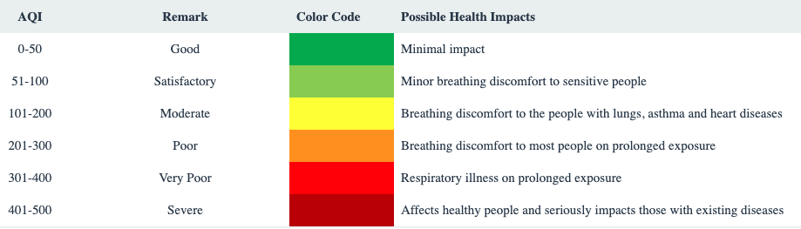
AQI Bucket

Slide 10
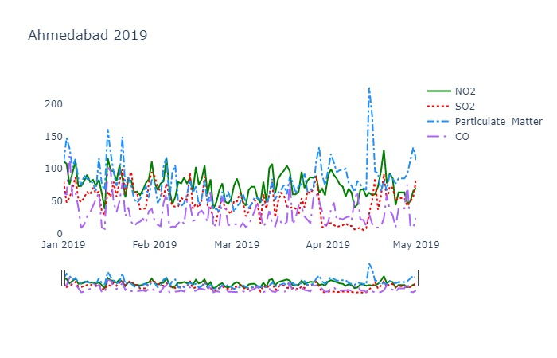
AQI Graph of Major cities
We have plotted a running graph from 2019-2020 to study the effect of lockdown

Slide 11
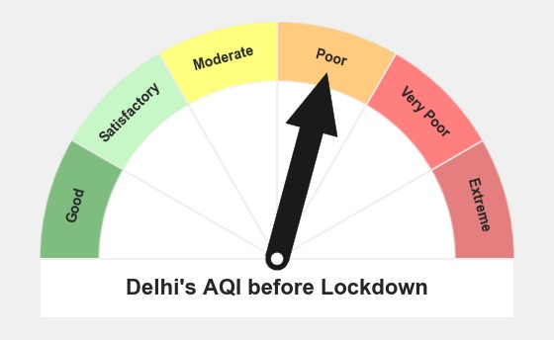
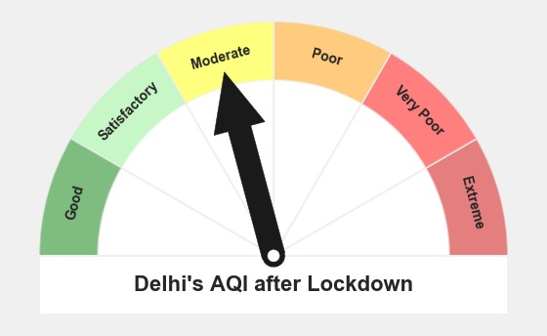
AQI Before lockdown vs After lockdown

Slide 12
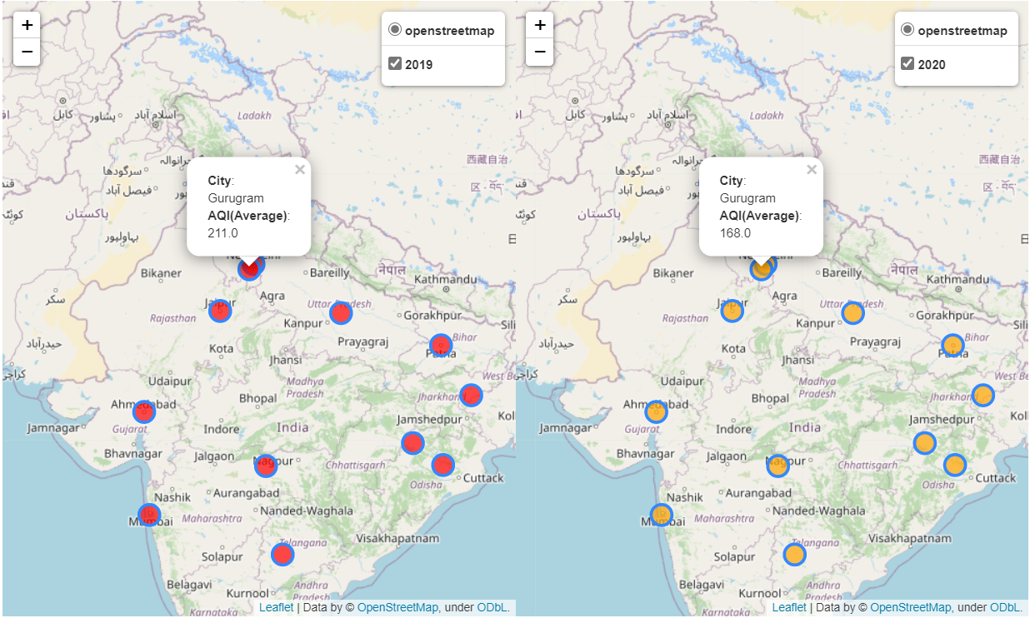
Double Map to Compare AQI

Slide 13
Conclusion for phase 2
We can see a slight drop in concentration of pollutants like SO3, NO2, CO etc. as well as PM because of the lockdown.
Due to less concentration of air pollutants there are less case of asthmas in 2020 and other air pollution related problems when compared to the previous years. So the lockdown was blessing in disguise for Air Quality Index.

Slide 14
Thank You

